Slide 1
Making Music With Programmable Logic
Matthew Harrison

Slide 2
Field Programmable Gate Arrays
Semiconducting device consisting of reprogrammable logic cells
Versatile applications
Peripheral modules
Embedded processing/System on Chip
Prototyping Application Specific Integrated Circuits

Slide 3
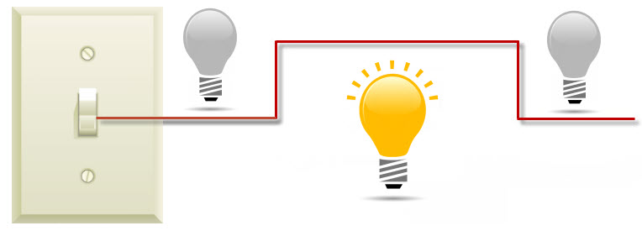
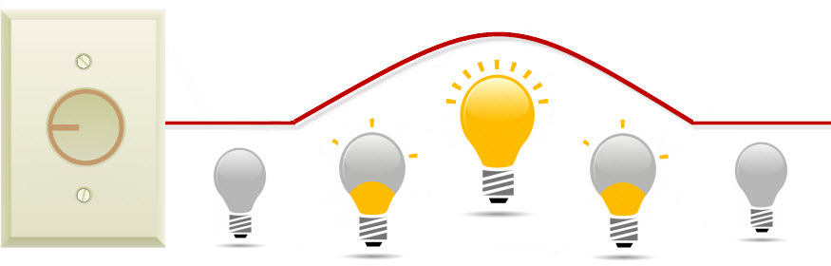
The Physics of Music
Sine waves
Discrete(sampled) vs. Analogue(continuous)
https://library.automationdirect.com/wp-content/uploads/2014/08/Lighton_off-ligit.jpg

Slide 4
Classic Analogue Instruments
Fender Rhodes
Piano style action
Hammers hit tines
Tines reverberate in tone bars
Magnetic pickup sends frequency to preamp
Hammond Drawbar Organ
Tone wheels driven by a motor
Frequency determined by motor speed, number of teeth on wheel, and the ratio of the number of teeth on the driving and driven wheel
Keys and drawbars activate magnetic pickups to amplify sound
Oscillator synths (Moog)
Divide oscillator speeds to get frequency

Slide 5
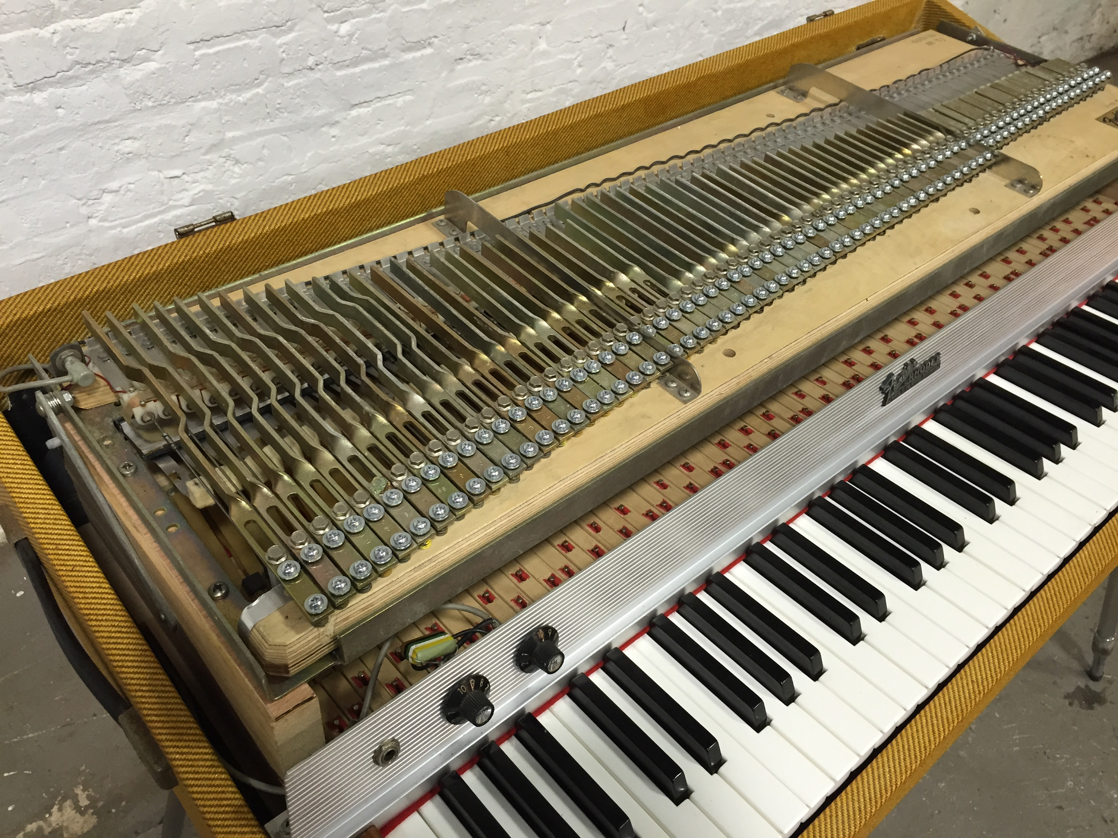
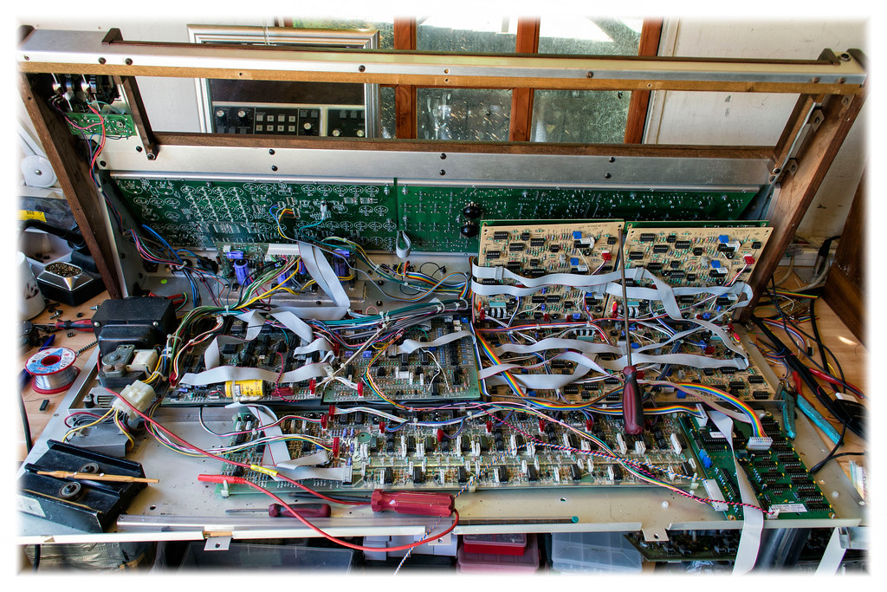
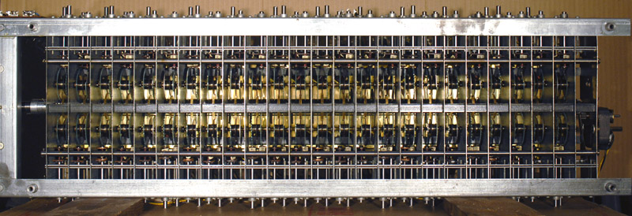
http://chicagoelectricpiano.com/wp-content/uploads/2015/09/IMG_1565.jpg
https://hiveminer.com/Tags/memorymoog
https://modularsynthesis.com/hammond/m3/m3.htm

Slide 6
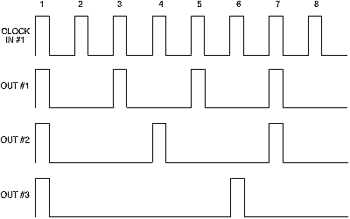
FPGA Analogue Synthesis
Clock signal similar to Hammond motor, exactly like Moog Oscillator
Divide clock to get frequencies
Determine output based on input signals
Output will be discrete without Digital to Analogue converter
With enough clock divisions, complex waves can be created
http://www.yusynth.net/Modular/EN/DIVIDER/index.html

Slide 7
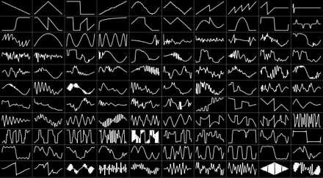
Other Methods of Making Music
Lookup table
Pre-recorded sounds
http://synthesizeracademy.com/wavetable-synthesis/

Slide 8
Digital Signal Processing
FPGAs are often used to process various electric signals
Filters
Mixing
Effects

